Slide 1
GIN stats statistics for experimental molecular biology
George Wiggins
John Pearson

Slide 2
Format
3 paired lectures
Theory
Practical
Topics:
Small experiments
?
?

Slide 3
Experimental molecular biology
Skills
Data (example)
Design
Statistics
Inference

Slide 4
Gene Knockdown Example
Question
Does geneX affect cell growth?

Slide 5
Gene Knockdown Example
Hypothesis
Deletion of a gene (geneX) will alter the growth of endometrial cancer cells.
Design
Two cell lines (AN3CA and EM-E6/E7-hTERT)
were transfected with three geneX targeted siRNA.
After transfection, proliferation (cell metabolism) of each experimental condition was measured by a MTT assay.
These experiments were repeated in triplicate across three weeks.

Slide 6
Gene Knockdown Example
Data
Analysis in Excel:
DummyData_MTT analysis.xlsx

Slide 7
Gene Knockdown Example
Results
Cell growth was significantly reduced …

Slide 8
Design
“Would another lab get similar results if they performed the same experiment?”
Design strategies
Randomize
Replicate
Reduce noise
Think about what you want to put in the results section of your paper/thesis.
What is the Inference you want to make?

Slide 9
Design Strategies
Randomize but don’t make it too easy to screw up
Replicate Variation that we do not want (technical)
and cannot control
Variation that we do want (biological)
How independent are my experimental reps?
How reproducible is my experiment?
Reduce noise Control for known sources of variation or confounders (also blocking)
Confounders are sources of variation that affect both the measurement and the treatment.

Slide 10
Design Example
Randomize but don’t make it too easy to screw up
Replicate Variation that we do not want (technical)
pipetting error
environmental conditions, reagents etc
Variation that we do want (biological)
Split cell stock or new passage?
Any conditions that are unique?
Cell specific? siRNA specific?
Reduce noise Control for known sources of variation or confounders (also blocking)
Cell growth differences in each experiment
Confounders are sources of variation that affect both the measurement and the treatment.

Slide 11
Design Example
Randomize but don’t make it too easy to screw up
Replicate Variation that we do not want (technical)
Pseudoreplication 3 technical reps
(repeat control and treatment in 3 wells)
Variation that we do want (biological)
Genuine Passage cells or go back to stock each week
3 biological reps separated by time and cells
2 cell types, 3 siRNAs
Reduce noise Control for known sources of variation or confounders (also blocking)
Growth taken relative to cells only in each experiment
Confounders are sources of variation that affect both the measurement and the treatment.

Slide 12
Statistics
How and why did we use:
t-test
ANOVA

Slide 13
Probability
Probability
Sums to 1
Observable values

Slide 14
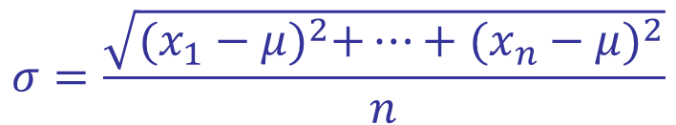
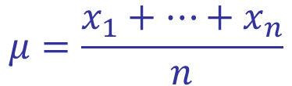
Normal Distribution
$$μ=\frac{x_{1}+…+x_{n}}{n}$$
$$σ=\frac{\sqrt{{(x_{1}−μ)}^{2}+…+{(x_{n}−μ)}^{2}}}{n}$$
68%
95%
99.7%
−
σ
−
σ
−
σ
μ
σ
σ
σ
3
2
2
3

Slide 15
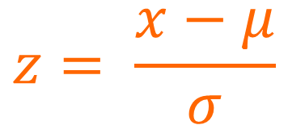
Normal Distribution
$$μ=\frac{x_{1}+…+x_{n}}{n}$$
$$σ=\frac{\sqrt{{(x_{1}−μ)}^{2}+…+{(x_{n}−μ)}^{2}}}{n}$$
68%
95%
99.7%
−
σ
−
σ
−
σ
μ
σ
σ
σ
$$z= \frac{x−μ}{σ}$$
3
2
2
3
−
3
−
2
−
1
0
1
2
3

Slide 16
Why is the Normal Distribution important?
Central Limit Theorem
adding together enough small independent effects produces a normally distributed result.
Distribution of sample mean is normal
https://gallery.shinyapps.io/CLT_mean/

Slide 17
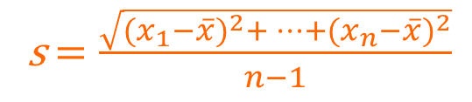
Inference
Distribution of sample mean is normal
We can infer the most likely value of the population mean, and quantify the inference.
s = sd of observations
 = mean of observations
s$=\frac{\sqrt{{(x_{1}−\overline{x})}^{2}+…+{(x_{n}−\overline{x})}^{2}}}{n−1}$

Slide 18
Inference: t test
Distribution of sample mean is normal
But we only have data from our experiment (it makes a difference in small samples)

s

Slide 19

Inference: t test
Distribution of sample mean is normal
But we only estimates from our experiment (it makes a difference in small samples)

s
$$\frac{\overline{x} − μ}{s/{\sqrt{n}}}\sim t_{n−1}$$
P values
Confidence intervals
Standard Error

Slide 20
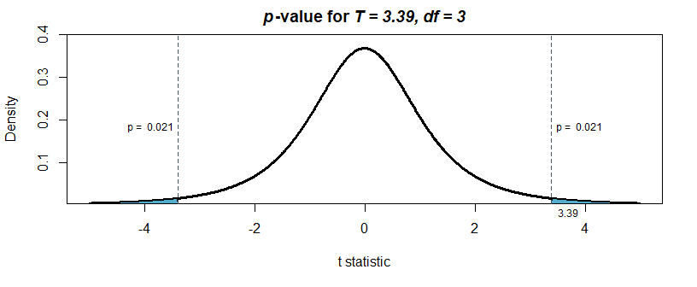
Inference: Example
 | Scramble | siRNA2
Mean | 0.431077 | 0.274614
Variance | 0.001133 | 0.005238
Observations | 3 | 3
Hypothesized Mean Difference | 0
df | 3
t Stat | 3.395269
P(T<=t) one-tail | 0.021305
t Critical one-tail | 2.353363
P(T<=t) two-tail | 0.042609
t Critical two-tail | 3.182446

Slide 21
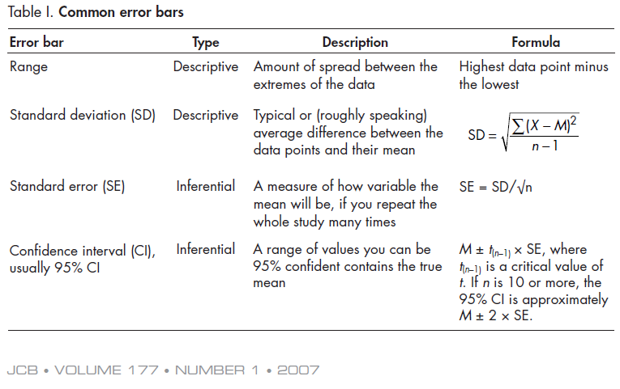
What errors bars to use?
Error bars in experimental biology, Cummings et al. J Cell Biol. 2007 Apr 9;177(1):7-11

Slide 22
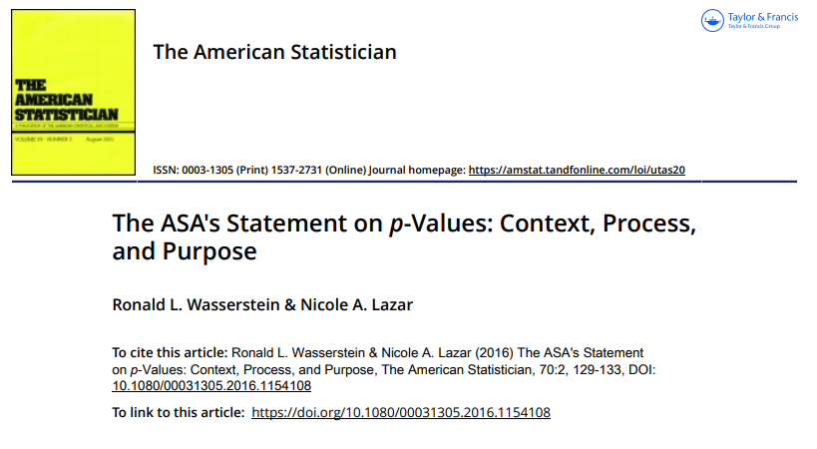

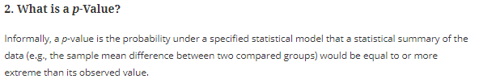
What does P mean
A p-value of less than 0.05 means that there is less than a 5% percent chance of seeing these results or worse, in the world where the null hypothesis is true.
(YouTube: Understanding the P value Dr Nic’s Maths and Stats)

Slide 23
What’s next
R …
Multiple testing
ANOVA
Correlation
Regression
Categorical
?

